Slide 1
Chapter 10
Point Estimation

Slide 2
Outline
Student Learning Objectives
Estimating Parameters
Estimation of the Expectation
Estimation of the Variance and Standard Deviation
Estimation of Other Parameters
Self-Quiz Review
Introduction to Unit 2 Assignment

Slide 3
Student Learning Objectives
Recognize issues associated with the estimation of parameters.
Define the notions of bias, variance and mean squared error (MSE) of an estimator.
Estimate parameters from data and assess the performance of the estimation procedure.

Slide 4
Estimating Parameters
The primary goal in statistic is to draw meaningful and solid conclusions on a given phenomena on the basis of observed data.
A key aspect in statistical inference is the association of a probabilistic model to the observations.
The basic assumption is that the observed data emerges from some distribution.
Usually, the assumption is that the distribution is linked to a theoretical model, such as the Normal, Exponential, Poisson, or any other model that fits the specifications of the measurement taken.
The target in statistical point estimation of a parameter is to produce the best possible guess of the value of a parameter on the basis of the available data.
An estimator is the statistic that tries to guess the value of the parameter. It is a formula applied to the data that produces a number, called the estimate.
The expectation of the measurement or the central location of the distribution, is an important characteristic of a distribution of interest.
A natural estimator of the expectation is the sample average.

Slide 5
Estimation of the Expectation
The Accuracy of the Sample Average:
Remember that the sample average is an estimator of the expectation.
The goal of this section is to assess the closeness of the estimator and the parameter we are trying to estimate. Ideally we would like the estimator to be closed to the parameter.
Assessing the closeness of the estimator to the parameter corresponds to the comparison between the distribution of the random variable, i.e. the estimator, and the value of the parameter.
In the case of the sample average is an estimator of the expectation, the assessment of the closeness of the estimator to the parameter is equivalent to the investigation of the spread of the distribution of the sample average about its expectation.
One method to for assessing the closeness of the sample average to the expectation it estimates is through a simulation or the Normal approximation (See the examples in Page 161-163 and let me know if you have any questions).
An alternative method for assessing the accuracy of an estimator of the expectation may involve the use of an overall summary of the spread of the distribution.

Slide 6

Estimation of the Expectation
The Accuracy of the Sample Average:
A standard method for quantifying the spread of a distribution about the expectation is the variance (or its square root, the standard deviation). Given an estimator of the expectation of a measurement, the sample average for example, we may evaluate the accuracy of the estimator by considering its variance.
The smaller the variance the more accurate is the estimator.
Below is the Variance of the Sample average:

Slide 7
Estimation of the Expectation
The Accuracy of the Sample Average:
The larger the sample size n, the smaller is the variance of the estimator, in which case the values of the estimator tend to be more concentrated about the expectation.
Hence, one may make the estimator more accurate by increasing the sample size.
Another method for improving the accuracy of the average of measurements in estimating the expectation is the application of a more accurate measurement device. If the Var(X) of the measurement device decreases so does the variance of the sample average of such measurements.
When we investigate the accuracy of estimators, we will generally use overall summaries of the spread of their distribution around the target value of the parameter.

Slide 8
Estimation of the Expectation
Comparing Estimators:
This section is about a more theoretical assessment of the estimator.
The question address here is: “How close are the unknown (and random) values of the estimator to a given value of the parameter?”
In the comparison between estimators we do not evaluate them in the context of the observed data. Rather, we compare them as random variables. The comparison deals with the properties of the estimators in a given theoretical context. Below are the steps we follow:
Assume in the comparison that the observations emerge from some distribution
Specify parameter values for this distribution and select the appropriate sample size
Compare the accuracy of one estimator against that of the other
Following the outlined steps above, the book compare the sample average to the sample mid-range as estimators of the expectation, when considering a Normal measurement. We see that the variance of the sample average is much smaller than that of the mid range. (Page 165- 166)
This shows that the accuracy of the sample average is better in this case than the accuracy of the mid-range estimator.

Slide 9
Estimation of the Expectation
Comparing Estimators:
We see from the example above that when considering a Normal measurement, the sample average is the best estimator for the expectation than the mid range.
The simulation in Page 166, shows that if we consider a Uniform distribution as the distribution of the measurement, the mid range now becomes the best estimator for the expectation than the mid range.
An important lesson here is that the distribution of the measurement will be a determining factor of the best estimator for the expectation.

Slide 10
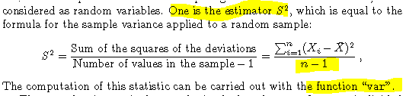
Estimation of the Variance and Standard Deviation
In the previous section we were dealing with the estimators for the expectation. This section deals with the estimators of the Variance and Standard Deviation
The following two estimators are compared to assess which one is the best estimator for the variance. Notice that the only difference between the two is that one is divided by n-1 and the other by n:

Slide 11
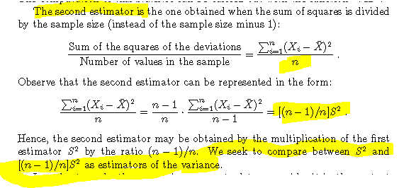
Estimation of the Variance and Standard Deviation

Slide 12
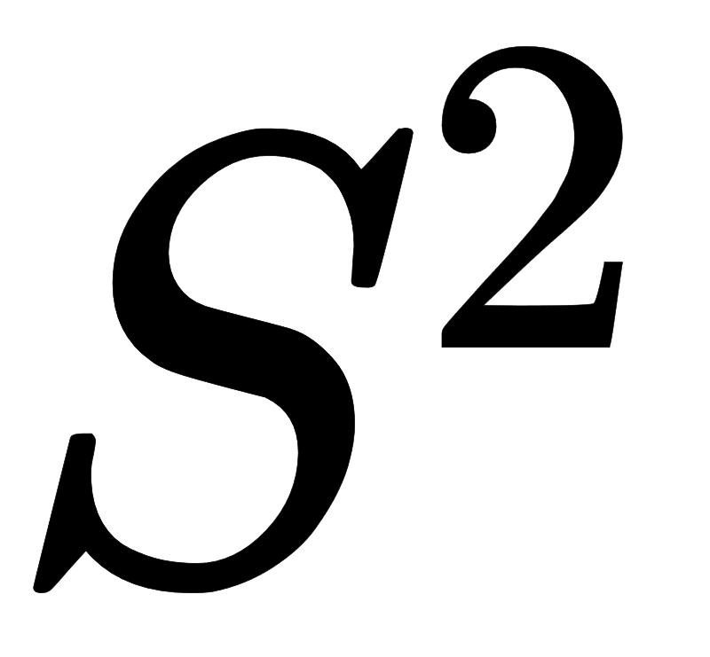
Estimation of the Variance and Standard Deviation
In the previous section we were dealing with the estimators for the expectation. This section deals with the estimators of the Variance and Standard Deviation
The first comparison of the estimators of the variance is to assess if the expectation of their sampling distribution equal to the value of the parameter being estimated.
The example from page 67-68 shows that is a better estimator of the variance than [(n-1)/n] because the expectation of its sampling distribution is closer to the target parameter.
An estimator is called unbiased if its expectation is equal to the value of the parameter that it tries to estimate.
Is an unbiased estimator of the variance; the sample average is an unbiased estimator of the expectation.
[(n-1)/n] is a biased value of the parameter since its expectation is not equal to the value of the parameter that it tries to estimate.
This also explain why for an estimator of the variance, is given by the formula with the denominator n-1 instead of n.

Slide 13
Estimation of the Variance and Standard Deviation
In the previous section we were dealing with the estimators for the expectation. This section deals with the estimators of the Variance and Standard Deviation
The first comparison of the estimators of the variance is to assess if the expectation of their sampling distribution equal to the value of the parameter being estimated.
The example from page 67-68 shows that is a better estimator of the variance than [(n-1)/n] because the expectation of its sampling distribution is closer to the target parameter.
An estimator is called unbiased if its expectation is equal to the value of the parameter that it tries to estimate.
Is an unbiased estimator of the variance; the sample average is an unbiased estimator of the expectation.
[(n-1)/n] is a biased value of the parameter since its expectation is not equal to the value of the parameter that it tries to estimate.
This also explain why for an estimator of the variance, is given by the formula with the denominator n-1 instead of n.
Since one of the estimator of the variance is biased while the other one is not, we need a new approach to compare their accuracy as estimators of the variance.
In order to achieve that comparison, the goal is to asses the distance between an estimator and the parameter it tries to estimate. We need to

Slide 14


Estimation of the Variance and Standard Deviation
The distance between the estimator and the parameter is measured as the mean squared error (MSE):
The bias of a estimator is the difference between the expectation of the estimator and the parameter it seeks to estimate
From the formula above, we can see that the Bias is 0 for an unbiased estimator because the expectation of the estimator is equal to the parameter
The formula for the MSE can be reformulated as followed:
[OPTIONAL] You can look at the derivation of the formula above here: https://www.youtube.com/watch?v=uyTFqesUfqY
The mean square error of an estimator is the sum of its variance, the (squared) distance between the estimator and its expectation, and the square of the bias, the square of the distance between the expectation and the parameter.
We then see that the mean square error is the sum of two distance: one distance accounts for the spread of the distribution about the expected value (the variance). The other distance accounts for the distance between the expected value and the parameter (the bias).

Slide 15
Estimation of the Variance and Standard Deviation
The mean square error becomes large if the variance or/ and the bias becomes large.
The mean square error (MSE) allows us to compare the estimators of the variance. In fact, the example inpage 170-171 shows that despite the estimator [(n-1)/n] is a biased estimator, overall it has a smaller MSE than .
Both the bias and the variance contribute to the mean square error of an estimator.
The price for reducing the bias in estimation is usually an increase in the variance and vice versa.
The consequence of producing an unbiased estimator such as is an inflated variance.
A better estimator is an estimator that balances between the error that results from the bias and the error that results from the variance.

Slide 16
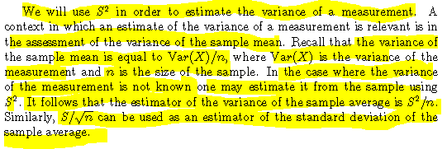
Estimation of the Variance and Standard Deviation

Slide 17
Estimation of Other Parameters
In the previous two section we considered the estimation of the expectation and the variance of a measurement.
The proposed estimators, the sample average for the expectation and the sample variance for the variance, are not tied to any specific model for the distribution of the measurement.
They may be applied to data whether or not a theoretical model for the distribution of the measurement is assumed.
This section deals with the estimation of the parameters that determines each of the following theoretical model: Binomial, the Poisson, the Uniform, the Exponential and the Normal models.
In the case of the Binomial distribution, the parameter is p, the probability of the success. A natural estimator for this parameter is the relative frequency in the sample. The relative frequency is the sample average that estimates the expectation of the Bernoulli measurement (remember this is the Binomial distribution for n=1).
The estimator of the parameter p is denoted by
This estimator is an unbiased estimator of p since

Slide 18

Estimation of Other Parameters
For the Poisson distribution, the sample average of the Poisson observations is an estimate for the parameter (the expectation of a Poisson measurement
The parameters of the Uniform distribution of the end-points of the interval over which the distribution is defined, a and b
A natural estimator of a is the smallest value observed. We can use the function “min” to compute this estimator
A natural estimator of b is the largest value. We can use the function “max” to compute this estimator
Both estimators are slightly biased but have a relatively small mean square error (MSE).
The Exponential distribution is characterized by the rate parameter h h
An estimator for this parameter is the reciprocal of the sample average since:
Hence,
The Normal distribution is characterized by two parameters: respectively the expectation of the measurement (with the sample average as an estimator) and the variance of the measurement (that can be estimated with the sample variance )

Slide 19
Self-Quiz Review
#https://youtu.be/a7LkgoFC6no
# Q1 to Q5: https://youtu.be/VjhDYdh9Zwg
# Q6 to Q8: https://youtu.be/S0-gs2RsgUA
# Q9 to Q10: https://youtu.be/3vpHE-zyuDw

Slide 20
Introduction to Unit 2 Assignment
# Q1 to Q6: https://youtu.be/9VwRw5Q3lpc
# Q7 to Q8: https://youtu.be/A5CFfPagQCU

